Slide 1
ANDY
THE VOICE ASSISTANT
(Basic Artificial Intelligence based on Python)

Slide 2

Submit for the partial fulfilment of Bachelors of Computer Applications Faculty of Engineering and Technology
University of Lucknow
Presented by:
Mohd. Bilal Ansari (190014045010)
Prabhat Rawat (190014045002)

Slide 3
Brief Introduction
We are familiar with many existing voice assistants like Alexa, Siri , Cortana which uses concept of language processing and voice recognition.
As these voice assistants are using Artificial Intelligence hence the result that they are providing are highly accurate and efficient.
It was an interesting task to make our own assistant .It becomes easier to send emails without typing any word, Searching on Google without opening the browser performing task on a single voice command.
Andy will take voice input from the user and perform the task accordingly.

Slide 4
PROJECT SCOPE
Andy can do almost similar task like cortana and Alexa but we have added some more functionalities in it some of the tasks it can perform are listed below:
It can send emails on your behalf without typing a word.
It can perform mathematical calculations without the use of Internet taking input as a voice command only.
It can read PDF files for you.
It can send Whatsapp messages.
It can perform voice searches on Google.
It can search and surf videos on Youtube.
It can open offline exe applications like Command Prompt, Notepad, IDE Music application etc.

Slide 5
WORKING
After running Andy it will greet you first as a Voice assistant than ask if there is anything he can do for you.
It will take input as a voice command by using speech recognition and after that it will convert that voice command into text called query .
Certain functions are executed by these query it is passed through functions which will search for certain keywords in query like “search on Google” or “send Email” after that task is performed accordingly.
When the query is performed it will start listening again for another task.
If it will not understand the query it will ask for it again like “Say that again please.

Slide 6
MODULES USED
pyttsx3: It is a python library which converts text to speech
SpeechRecognition: It is a python module which converts speech to text.
pywhatkit: It is python library to send WhatsApp message at a particular time with some additional features.
Datetime: This library provides us the actual date and time.
Wikipedia: It is a python module for searching anything on Wikipedia.
Smtplib: Simple mail transfer protocol that allows us to send mails and to route mails between mail servers.
pyPDF2: It is a python module which can read, split, merge any PDF.
Pyjokes: It is a python libraries which contains lots of interesting jokes in it.
Webbrowser: It provides interface for displaying web-based documents to users.

Slide 7
Pyautogui: It is a python libraries for graphical user interface.
os: It represents Operating System related functionality.
sys: It allows operating on the interpreter as it provides access to the variables and functions that usually interact strongly with the interpreter.
PyQt5: PyQt is widely used for creating large-scale GUI-based programs. It gives programmers the freedom to create GUIs of their choice while also providing a lot of good pre-built designs. PyQT gives you widgets to create complex GUIs.

Slide 8
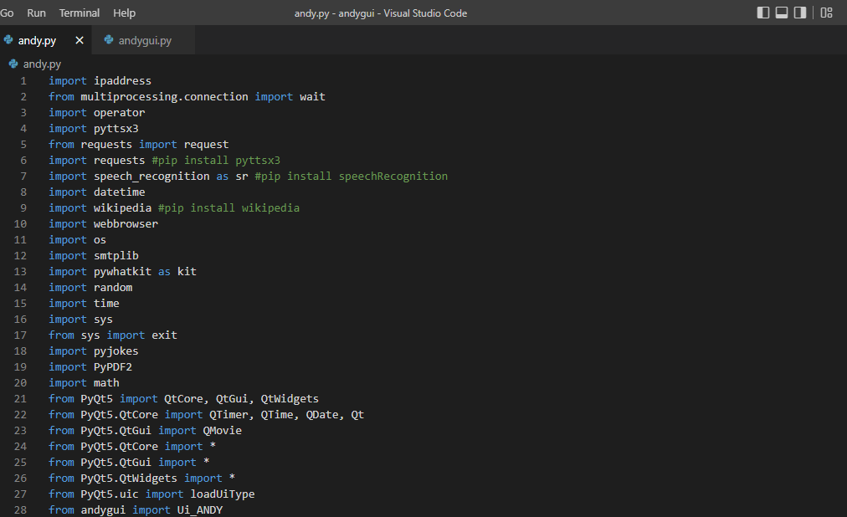
MODULES

Slide 9
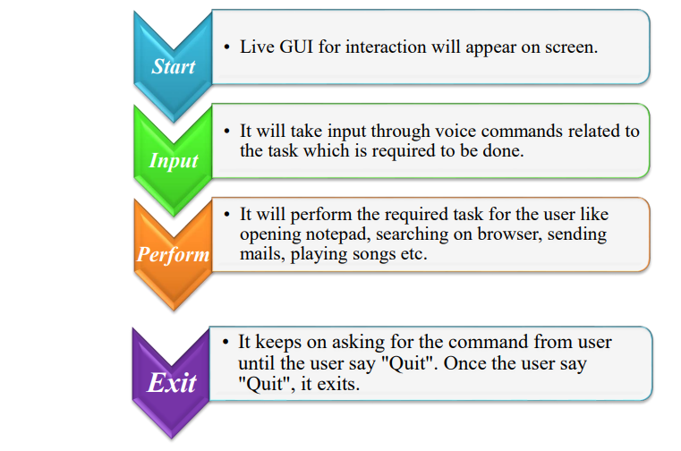
DATA FLOW

Slide 10
REAL LIFE APPLICATION
Saves time
Conversational interaction
Reactive nature
Multitasking
No Trigger phase

Slide 11
FEW MAIN FUNCTIONS
takeCommand(): The function is used to take the command as input through microphone of user and returns the output as string.
wishMe(): This function greets the user according to the time like Good Morning, Good Afternoon and Good Evening.
taskExecution(): This is the function which contains all the necessary task execution definition like sendEmail(), pdf_reader(), news() and many conditions in if condition like “open google”, “open notepad”, “search on Wikipedia” ,”play music” and “open command prompt” etc.

Slide 12
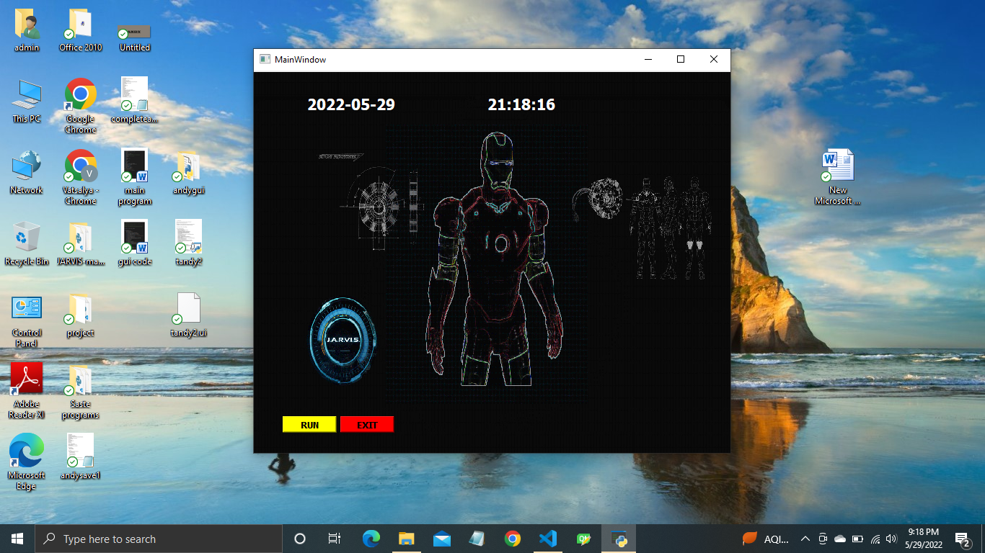
INPUT/OUTPUT SCREENSHOTS

Slide 13
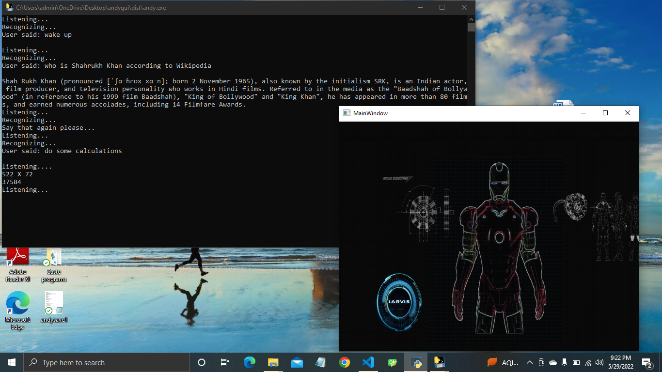
SEARCHING ON WIKIPEDIA

Slide 14
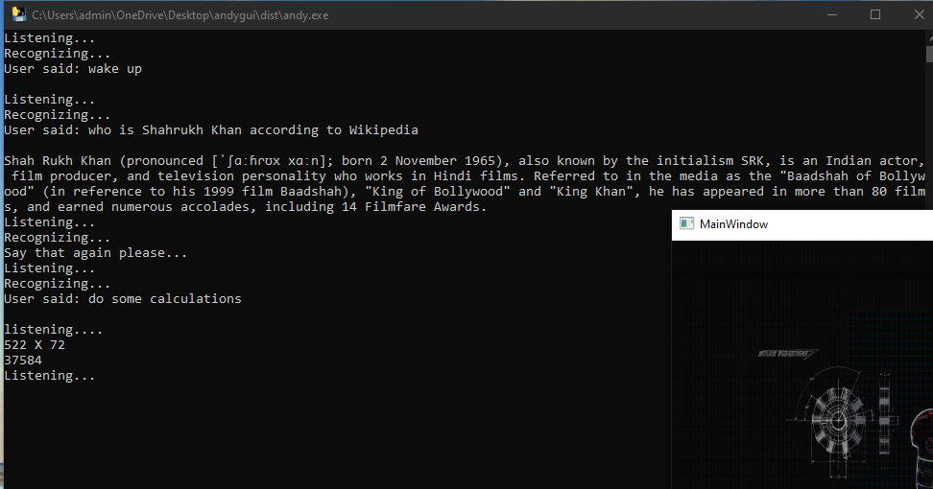
PERFORMING VERBAL CALCULATIONS

Slide 15
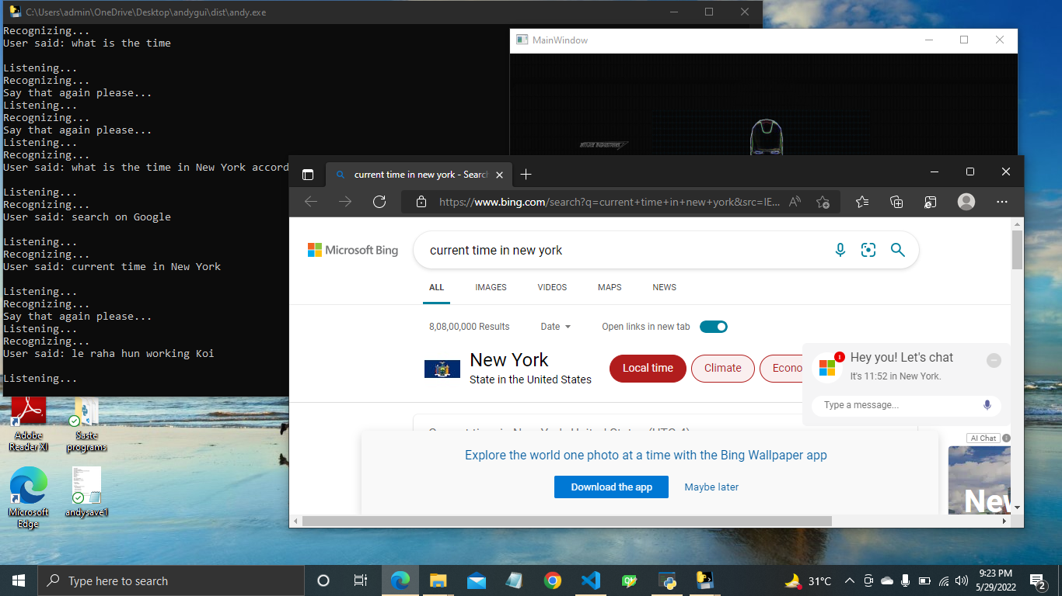
SEACHING ON BROWSER

Slide 16
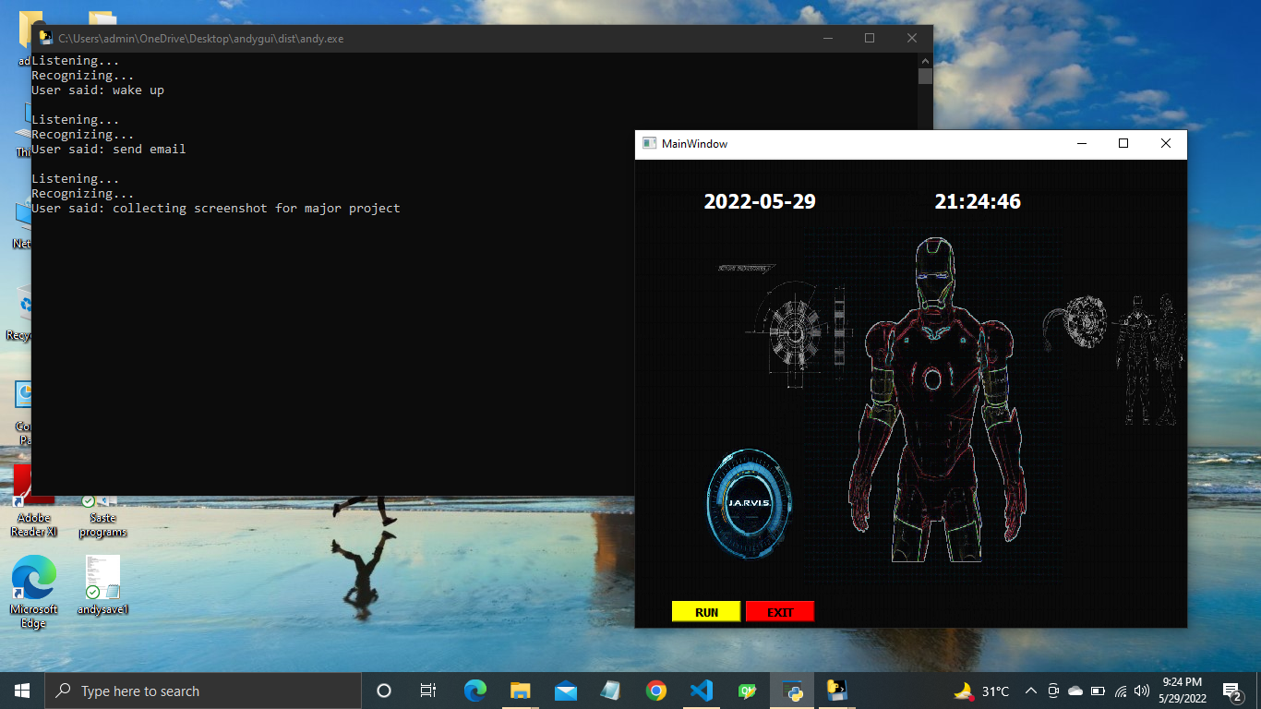
SENDING EMAIL

Slide 17
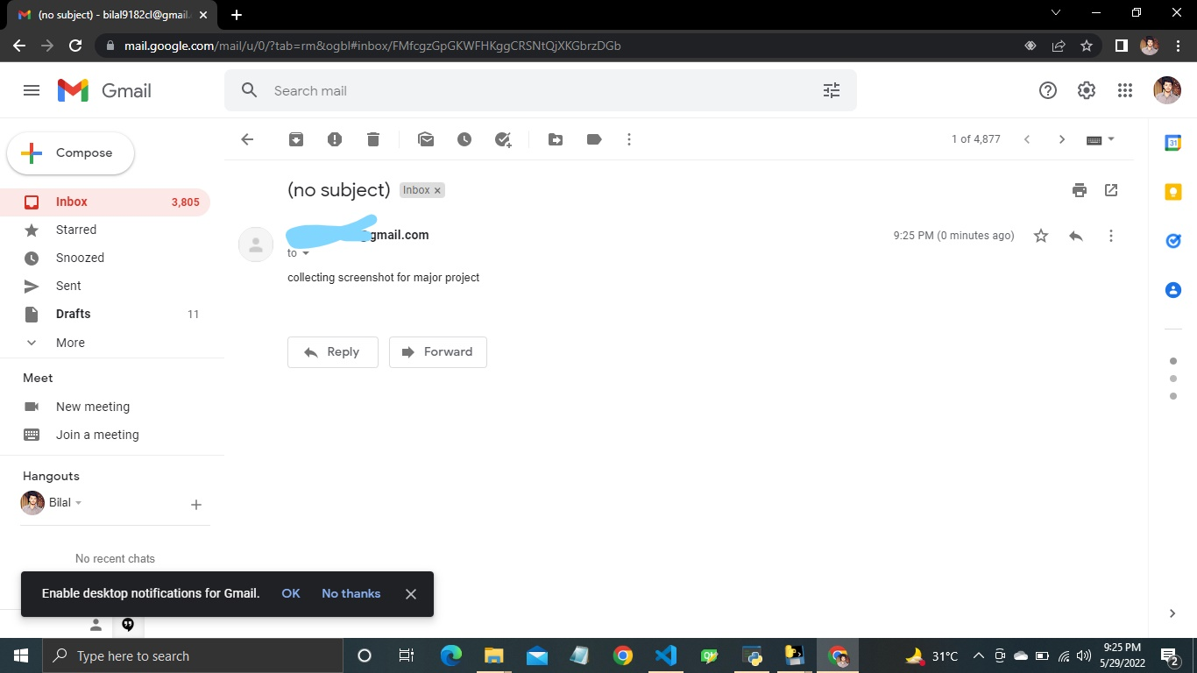
EMAIL SENT

Slide 18
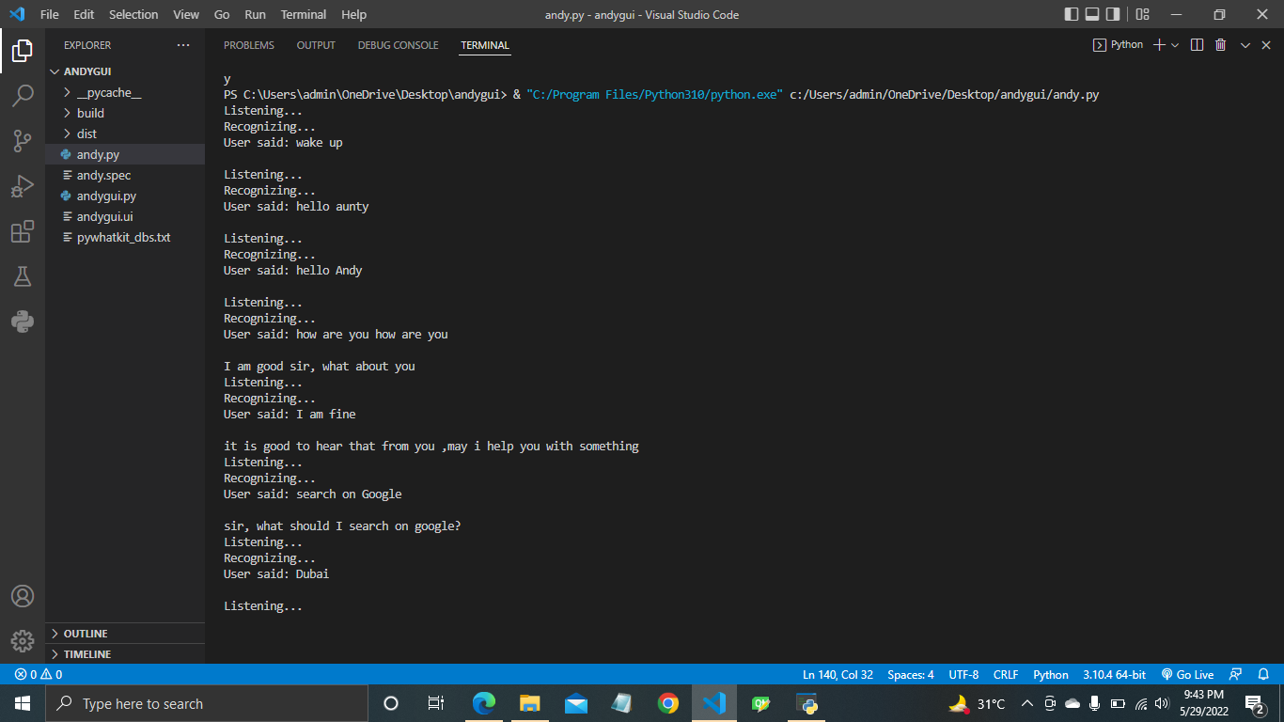
BASIC CONVERSATION

Slide 19
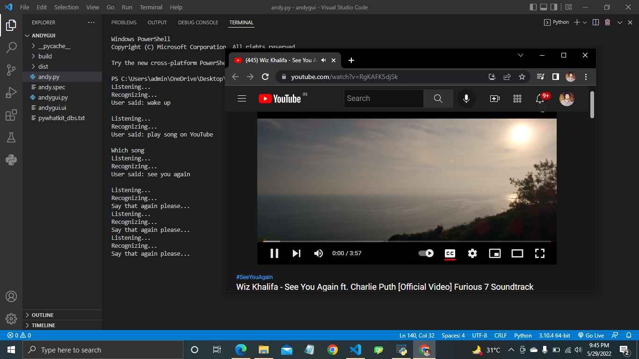
PLAYING SONG ON YOUTUBE

Slide 20
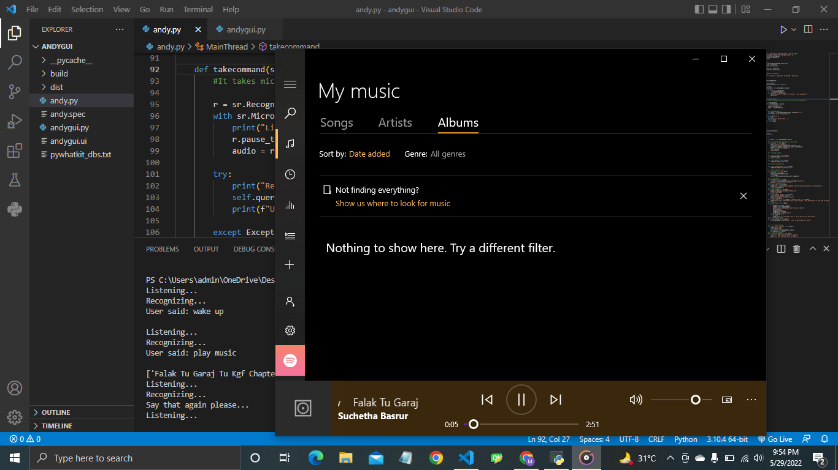
PLAYING OFFLINE MUSIC

Slide 21
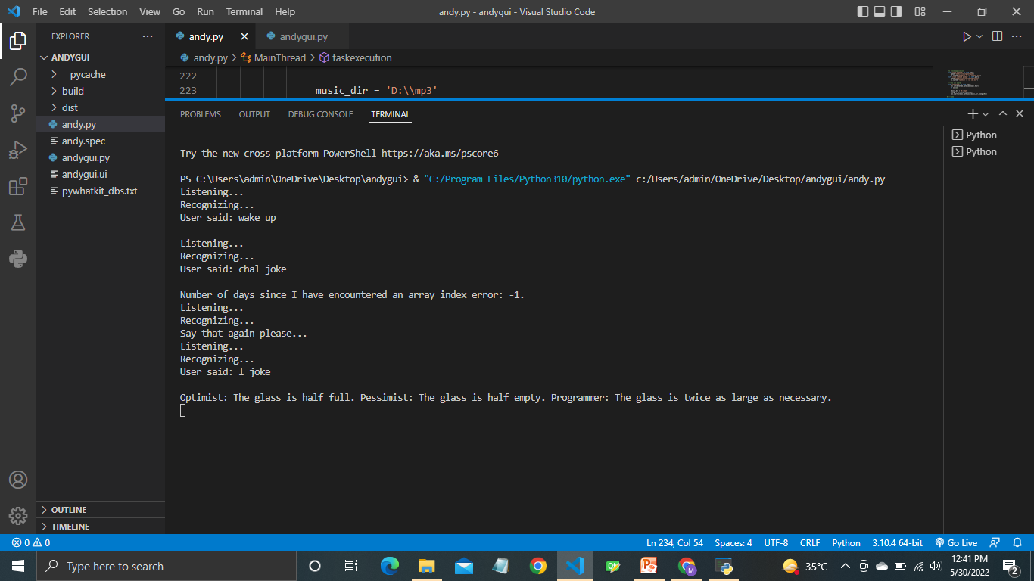
JOKE FUCTION

Slide 22
ADVANTAGES
Easy to use.
Can work with variety of commands.
Helpful for Disabled person.
Several functionalities can be added there is no limit to it.
Some functions are network independent.

Slide 23
LIMITATIONS
Security is somewhere an issue, there is no voice command encryption in this project.
Background voice can interfere.
Misinterpretation because of accents and may cause inaccurate results.
ANDY cannot be called externally anytime like other traditional assistants like Google Assistant can be called just by saying, “Ok Google!”.

Slide 24
SCOPE FOR FUTURE WORK
Make ANDY to learn more on its own and develop a new skill in it.
ANDY android app can also be developed.
Make more ANDY voice terminals.
Voice commands can be encrypted to maintain security.

Slide 25
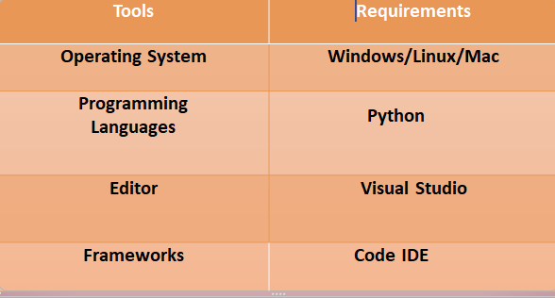
SOFTWARE REQUIREMENT

Slide 26
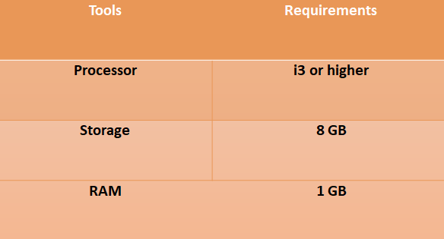
HARDWARE REQUIREMENTS

Slide 27
REFERENCES
Artificial Intelligence : The Basics– By Kevin Warwick
Artificial Intelligence – A Modern Approach (3 Edition)
Fluent Python: Clear, Concise, and Effective Programming

Slide 28
THANKYOU

